Slide 1
YOLO – Based Helmet and Safety Gear Detection
Subject: Applied Machine Learning (CS 713) Instructor: Aymen Ben Said
Presenting By:
Vinit Rathod (Student ID: 200528537)
2025, June 9
Notes:
Hello guys,
First of all good morning.
So today I am going to present on project title.
Subject is Subject Name,
I would like to thank our professor for giving us this oppurtunity.
I can already see some tired faces come on guys there is still long way to go and hear everyones presentation.
Hemin all good no you saw your watch probably thinking when this guy is gonna complete the presentation.
And yeah of course I will be presenting this project to you guys so yeah you all are stuck with me for next 15 minutes.
Okay so lets start the presentation without wasting any more time.

Slide 2
Table of Contents
Problem Statement
Technology Used
Method
Results
Demo
Question and Answer
Notes:
So these are the things that we gonna go through in the these presentation
We will start with the problem statement and how I got motivation to create this project
Technology Used when creating the project.
The methodology how I trained my model what hyperparameters I used to train the model and regarding the dataset that I have used to train the model.
Next we are going to discuss about the results graphs what I got when I trained my model and tested it on testing images
Last but not least a demo of how my project look likes and you will be able to see some real time detection of the ppe(personal protective equipment).

Slide 3
Motivation
Preventable Accidents Hurt Real People
Manual Checks aren’t enough
Specific Challenges
Page 1
Notes:
Before Starting with first part of my presentation can I please get a raise of hand how many of you witness unsafe PPE practices.
As a Home Depot associate I witness daily safety risks that could be prevented with better ppe compliance.
This project was born from the real world issues that we witness daily and a deep commitment to protecting our team or work colleagues.
So this are the reason I built helmet and safety gear detection.
1st point
Many times I notice that seasonal workers often skip ppe during rush hours, risking object falls , cuts or even worse.
We can prevent this if we had real time alerts so that the injury might never have happened
2nd Point
Supervisors can't keep watch in every aisle, department especially during the peak hours
Safety audits are reactive checking the camera making a report after the incident already happened instead of proactive
We need some one that keeps an eye out and never blinks.
3rd point
Many times supervisor can also face specific challenges like if we talk about our region in regina in winter times it gets extreme cold and due to that many employees wear bulky clothing, making ppe harder to spot
This just isn't about rules this is about the protection of our family, friends and colleagues.

Slide 4
Technology Used
Core Technology
YOLOv5
Pytorch
For web app
Flask
Pytorch
OpenCV
Javascript
HTML/CSS
Page 2
Notes:
Read out the whole slide first
Now you guys must be thinking why I used yolov5 instead of yolov8 that is the newest version, the thing is that is some aspects yolov5 outperforms yolov8 one of the example:
1) we can take is the speed and accuracy. For the accuracy yolov8 performs better and for the speed or the real time detection yolov5 works better the thing is that yolov5 inference speed is more than yolov8
And when it comes to real time detection speed is the most critical thing we take into account.
Now you must all be thinking what is inference speed. it is basically how fast our model can process new data image or vidoes and generates predictions.
It takes different parameters into account like FPS (Frames per second), latency and Throughput that is batch processing rate (imgs/sec)
It can be helpful trigerring audio alarms before an employee/site worker enter's the danger zone.
2) and regarding the pytorch it is more compatible with yolov5. Giving us more inference speed, less training time and less gpu memory use.

Slide 5
YOLOv5 Architecture
Layer Type | Function | Key Feature for PPE Detection
Backbone (CSPNet) | Feature extraction | Lightweight CSPDarknet53 for real-time processing
Neck (PANet) | Multi-scale feature fusion | Detects small helmets/vests in crowded scenes
Head | Prediction (bbox, class, confidence) | Outputs 3 detection scales (P3-P5)
Page 3

Slide 6
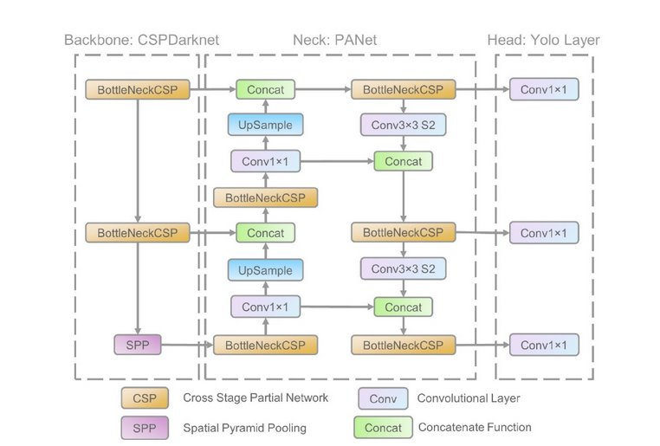
https://iq.opengenus.org/yolov5/
Page 4

Slide 7
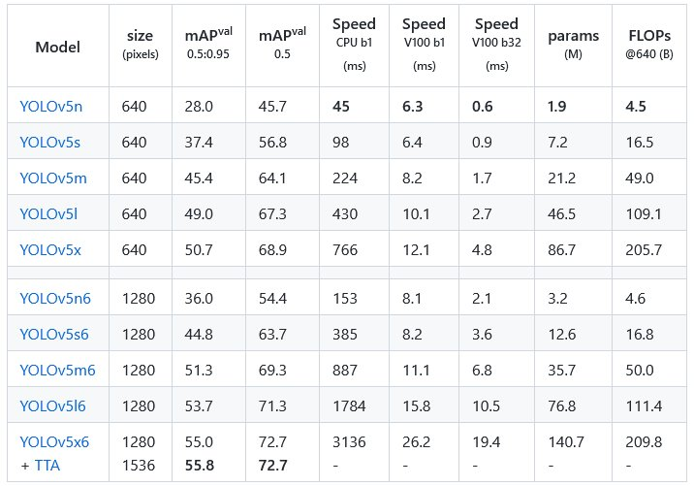
https://iq.opengenus.org/yolov5/
Page 5

Slide 8
Methodology
Two Datasets which includes :
PPEs (Personal Protective Equipment)
Construction Site Safety Dataset
Page 6
Notes:
I have used roboflow dataset to train my models, mainly roboflow provides a free public dataset in many popular formats example JSON, COCO JSON, Yolov5, Yolov8 etc
So the total images that was in the dataset was around 2801 and the 93% of its goes to the training set, around 4% to the validation set and the rest of the part is used for testing the model around 3%
So I have used the dataset that already has the annotations file wait a second I will show you guys
Talk about preprocessing auto orient, resize stretch to 640x640
Talk about augmentations Flipping the images horizontally Cropping the images, rotation between –12 deg to +12 deg Grayscale has been applied, hue saturation brightness exposure blur cutout mosiac
For Dataset 1
In training set we have around 19K images resize to 416 x 416
Augmentations that applied to the first dataset was flip crop saturation brightness exposure blur and added noise in the images
Explain about dataset 2
Training data size testing data size and the augmentations that were applied on the dataset 2

Slide 9
Summary for the PPE dataset
Metric | Value | Interpretation
mAP50 | 0.327 | Marginal Detection Quality
mAP50-95 | 0.171 | Tight Bounding Box
Precision | 0.344 | 34.4% of detections were correct
Recall | 0.422 | Many Missed Objects
Page 7

Slide 10
Summary for the Construction Site Safety Dataset
Metric | Value | Interpretation
mAP50 | 0.817 | Excellent Detection Quality
mAP50-95 | 0.485 | Moderate Precise Localization
Precision | 0.867 | Low False Positive Rates
Recall | 0.772 | Good Coverage
Page 8

Slide 11
Hyperparameters
Parameter | Value | Rationale
batch_size | 16 | Max GPU VRAM utilization
lr0 (Initial Learning Rate) | 0.01 | Avoids Overshooting
fliplr | 0.5 | Simulates varied worker poses
Optimizer | SGD | Classic choice for stable convergence.
hsv_s | 0.7 | Simulates harsh warehouse lighting variations
Page 9
Notes:
Explain Stochastic Gradient Descent, it updates model weights to minimize loss using learning rate, Gradient loss and momentum.
The reason for chosing Stochastic Gradient Descent because it behaves like a weighted ball rolling down hills, maintaining direction ever when gradients get noisy. This was critical when detecting small PPE items like masks

Slide 12
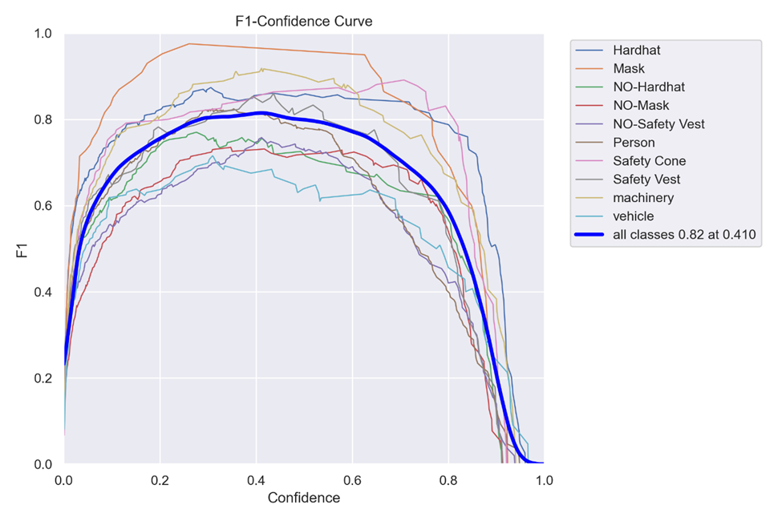
Results
Page 10
Notes:
Thick blue line is the aggregrated F1 curve across all the classes
The label says the maximum F1 score across all the classes in 0.82
And at confidence threshold 0.42 we get the highest f1 score
Using this graph we can select a confidence threshold that give us the best performance for our model.

Slide 13
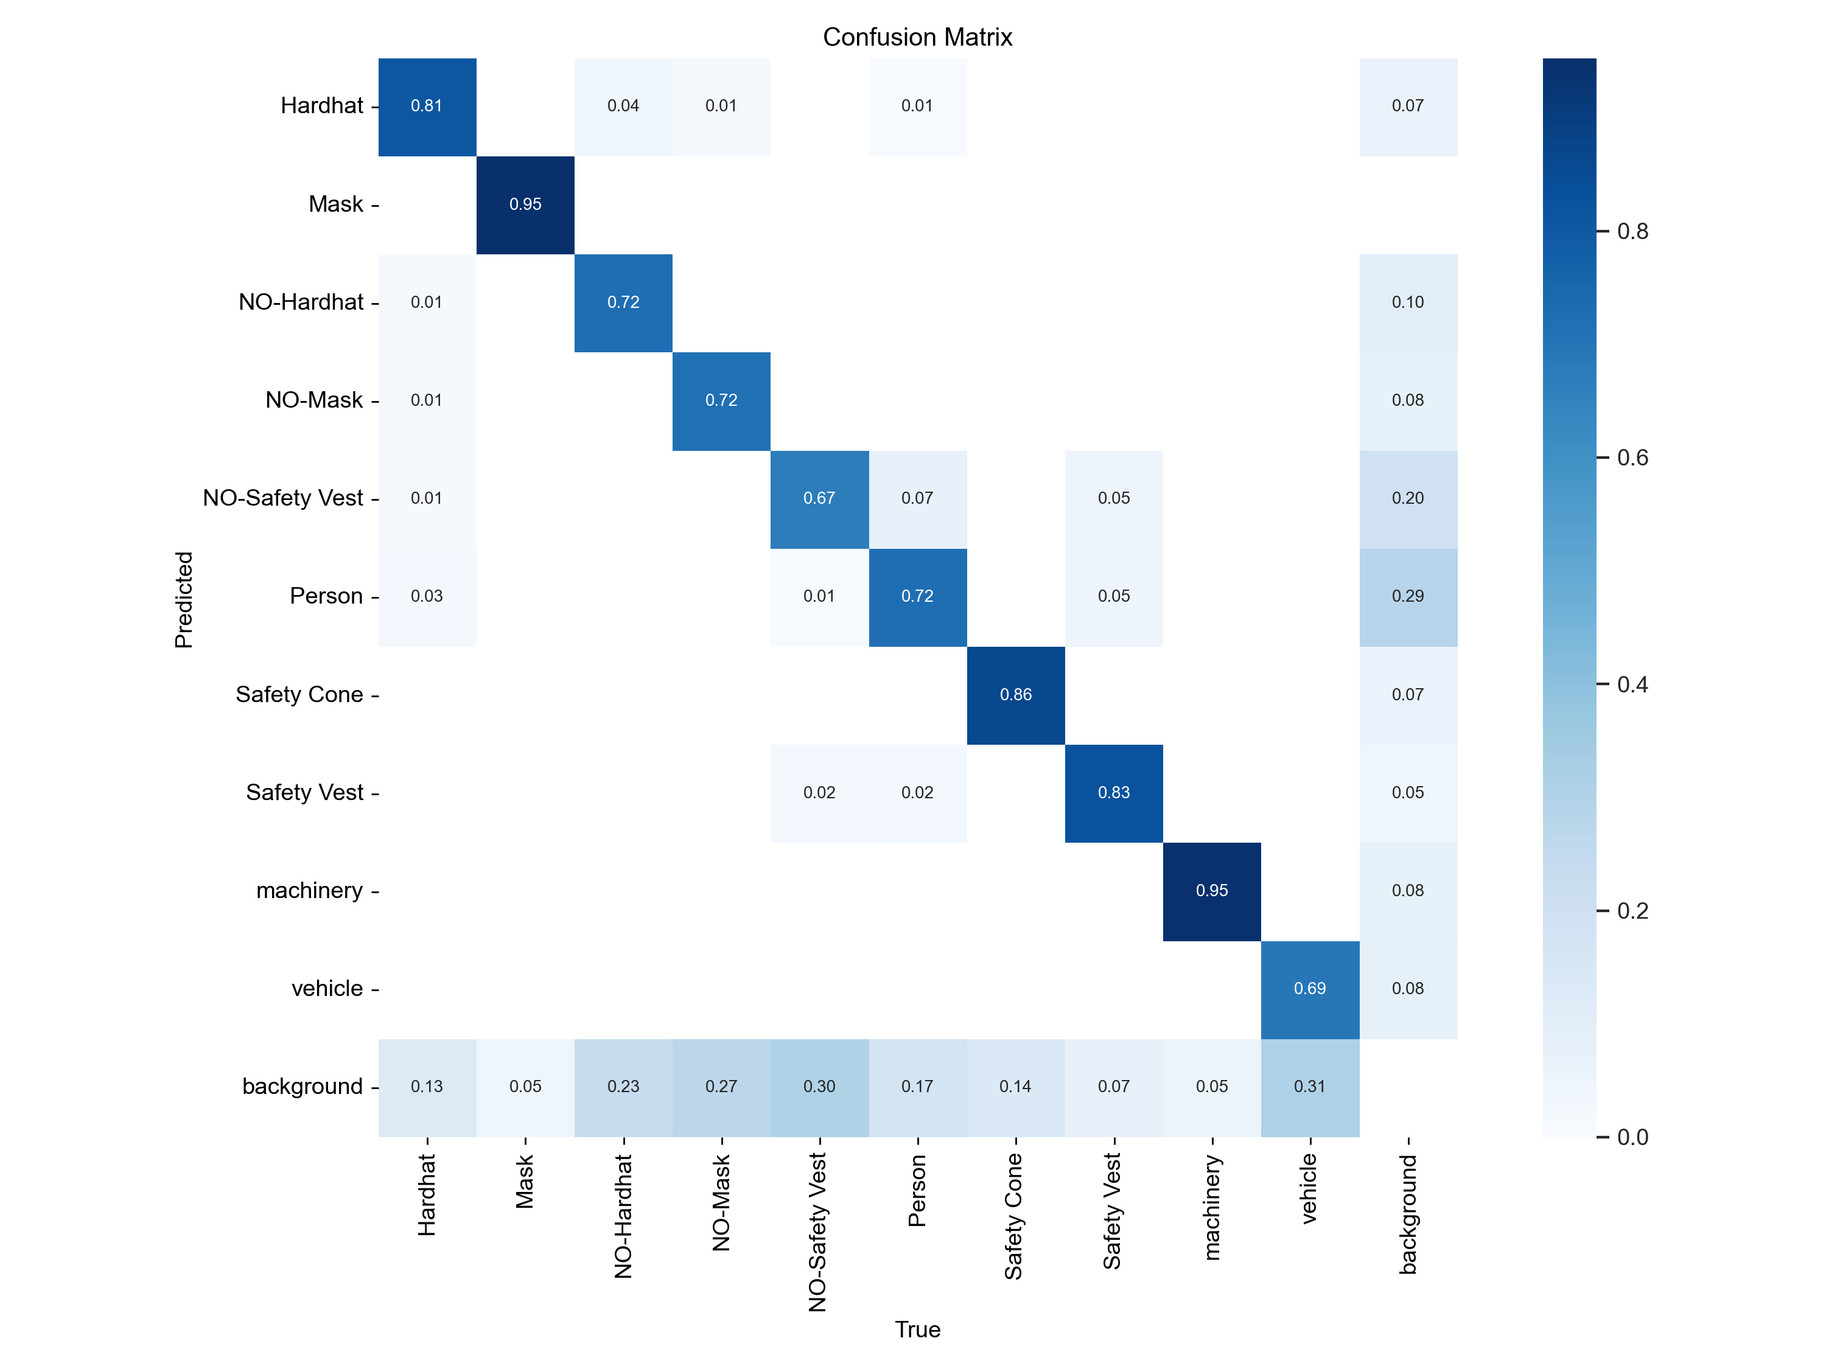
Confusion Matrix
Page 11

Slide 14
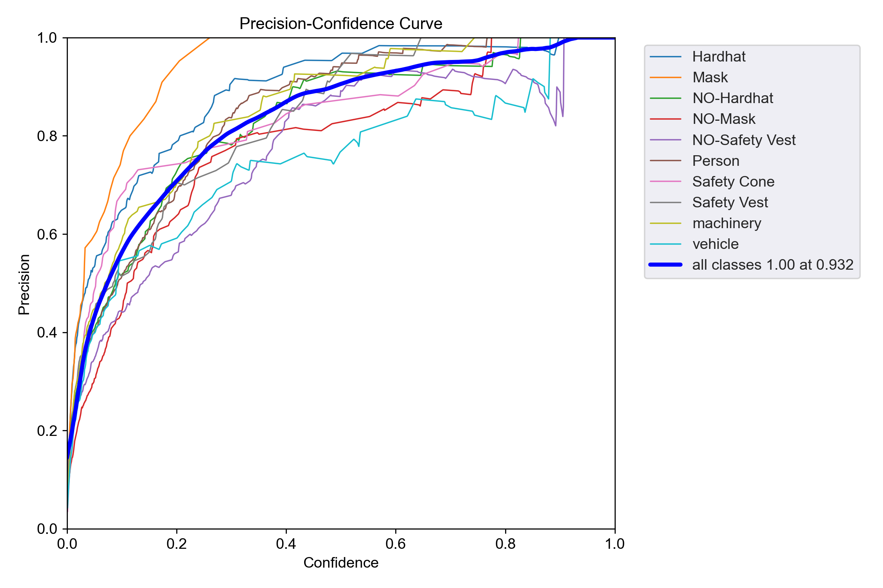
Precision Curve
Page 12
Notes:
Thick blue line is the aggregrated F1 curve across all the classes
The label says the maximum F1 score across all the classes in 0.82
And at confidence threshold 0.42 we get the highest f1 score
Using this graph we can select a confidence threshold that give us the best performance for our model.

Slide 15
Training Summary
50 epochs completed around 3 hours
Fast training time indicates efficient GPU utilization (likely my RTX 4070)
Model size: 14.5MB (YOLOv5s small variant)
Architecture: 157 layers, 7.04M parameters, 15.8 GFLOPs (suitable for real-time detection)
Page 13

Slide 16
Class | Images | Instances | Precision | Recall | mAP50 | mAP50-95
All | 114 | 697 | 0.867 | 0.772 | 0.817 | 0.485
Hardhat | 114 | 79 | 0.94 | 0.785 | 0.886 | 0.551
Mask | 114 | 21 | 1 | 0.935 | 0.956 | 0.675
NO-Hardhat | 114 | 69 | 0.866 | 0.656 | 0.75 | 0.38
NO-Mask | 114 | 74 | 0.812 | 0.662 | 0.678 | 0.337
NO-Safety Vest | 114 | 106 | 0.818 | 0.679 | 0.701 | 0.357
Person | 114 | 166 | 0.9 | 0.741 | 0.859 | 0.49
Safety Cone | 114 | 44 | 0.842 | 0.864 | 0.858 | 0.514
Safety Vest | 114 | 41 | 0.853 | 0.849 | 0.888 | 0.522
Machinery | 114 | 55 | 0.891 | 0.927 | 0.954 | 0.652
Vehicle | 114 | 42 | 0.746 | 0.619 | 0.64 | 0.369
Page 14

Slide 17

Live
Demo
Page 15

Slide 18
Thank you For your Attention
Page 16

